Slide 1
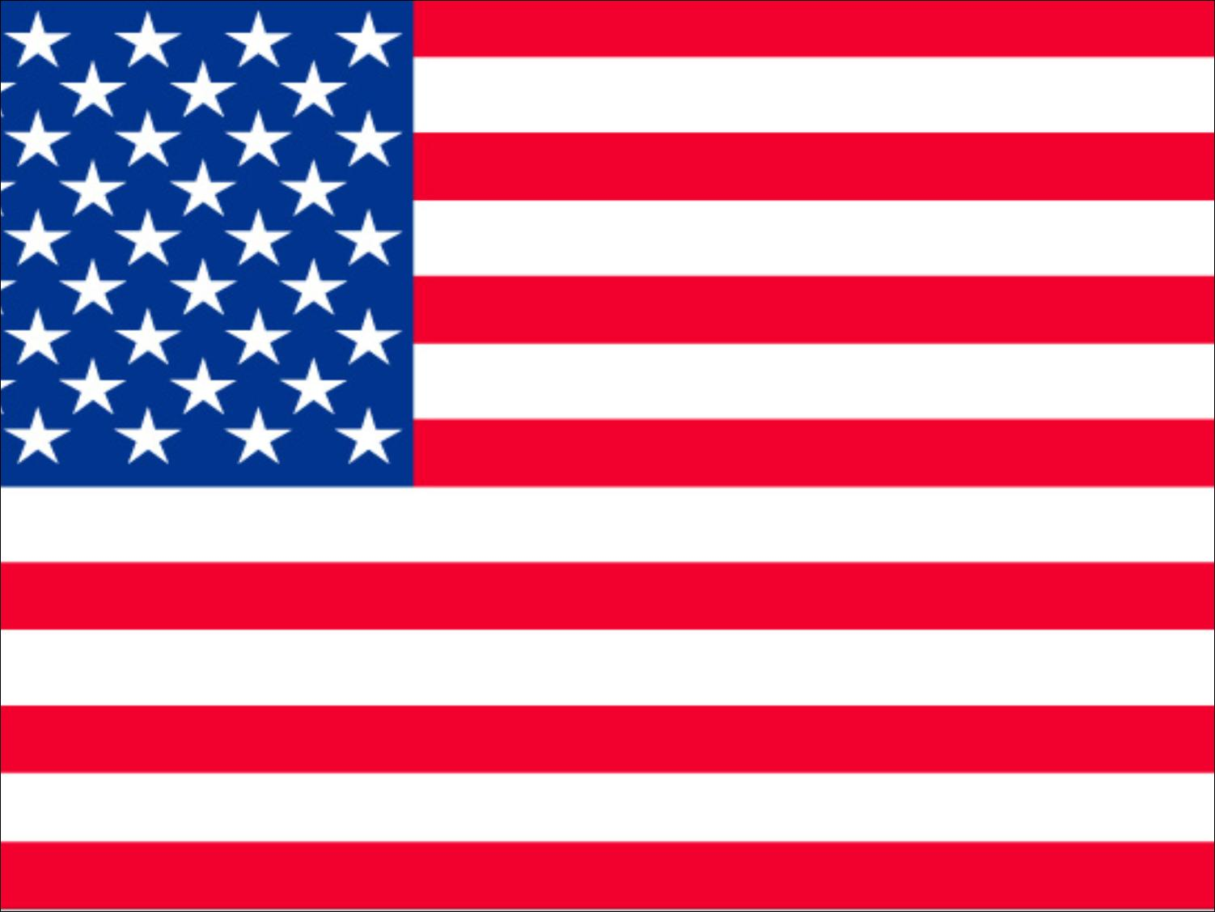
Unit 1 Review
By Danny Grewal

Slide 2
Definitions
Imperialism – is the domination of one group over another
Open door policy - is a policy that was created so that western countries can trade with china.
Dollar Diplomacy - is the term used to describe the effort of the United States to gain more of a foothold in foreign policy regard Latin American and East Asia by giving loans to foreign countries.
Great white fleet - was a military enterprise where they sent 16 battleships around the world to show off the nation’s military power.
Commodore George Dewey led his squadron into Manila Bay in the Philippines in the early morning of May 1st 1898 and destroyed several Spanish battleships with no deaths or injuries.
Joseph Pulitzer was a writer and owner of the newspaper ‘World’ and is famous for writing stories then circulating them around the country regarding Spanish atrocities in Cuba.

Slide 3
Definitions Cont’d
Captain Alfred T. Mahan was an officer in the U.S. Navy who was a teacher at the Naval War college, he argued the point that most prosperous nations had a large merchant fleet so they could also trade with the rest of the world as well as large navy’s to protect them.
The Roosevelt Corollary was an address to the congress in 1904 regarding the fact that America would intervene in Latin America in order to maintain economic and political stability.
Pan-Americanism is a concept that invites both Latin American and America to work together to promote peace and to increase trade.
Jose Marti was a passionate writer who devoted himself to helping Cuba gain independence.

Slide 4
Imperialism
Definition: a policy of extending the rule or authority over foreign countries.
Reasons for Imperialism:
  We thought we were better
  We saw it as our duty
  We were the only civilized race that could do it.
  We wanted to become a world super power.

Slide 5
U.S. Imperialist Policy
We wanted to show off our navy to the world.
Expansion in the Pacific
Trade and Diplomacy in Latin America
The growth of our navy
American’s felt superior

Slide 6
The Panama Canal
Teddy Roosevelt was the president who pushed for the canal to be built.
The first attempt at making the canal was done by the French.
  The French government had a scandal within their government.
  This almost caused the government to crumble.
America influenced the Panamanian revolution.
Who was in charge:
  Colonel George Goethals engineered the building of the canal.
  Colonel William Gorgas was the sanitation engineer.
History:
  Started in 1904-1914
  52 miles long, this includes a 22 mile long lake in the middle.
  When you enter the canal, you are further east than you exit on the Atlantic side.
  We gave the Panama Canal to Panama after 100 years.
  Our Military has the right to go through the canal and skip the line.
  Our military also has the right to intervene should the need arise.

Slide 7
Our Navy
America wanted a big because the general public was more willing to risk war in the defense of the countries international interests. Supporters were also worried that if they didn’t act quickly they would lose their foothold in overseas market.

Slide 8
The Spanish War: Causes and Location
The Spanish American war was fought in the Philippines, Cuba and the surrounding islands.
The explosion of U.S.S Maine in Havana Bay, Cuba. The Americans then blamed the explosion on Spain thus allowing war to erupt.
Cuba was in the midst of a revolution and most Americans viewed Spain and its monarchy as tyrants therefore America supported the Cubans in their fight for independence as well as the fight against Spain.

Slide 9
The Maine
The Naval experts that had examined the ship had not disapproved the possibility that a low charge from outside the ship had been the fatal explosion and instead ruled out the probable cause of a fire on the boat.
It would be logical to think that the Maine was hit by a Spanish mine, as Cuba at the time was a Spanish colony.
The fact that the sides and deck of the sheep were peeled back showing that there had been a large internal explosion as well as the fact that mines available at that time would not be powerful enough to cause that sort of reaction.
After later examination it was found that the Maine had been exploded from the inside out and it was by accident however this fatal accident led to the Spanish-American War.

Slide 10
Repercussions
Philippines felt betrayed by the American government because whilst they freed them from the Spanish Empire, they also turned the Philippines into an American Colony due to the fact that they were not civilized enough to have their own government.
The Platt Amendment gave several rules that the nation had to follow; it could not make a treaty with any other country, Cuba had to allow the U.S. to buy and lease naval stations, keep a low debt and America would have the right to intervene in Cuba in order to protect Cuba and its independence.

Slide 11
The Spanish American War summary
The Spanish American war was 1898-1898. 6 months long and was against the Spanish in the Spanish Colonies. (Cuba, Puerto Rico)We also fight in the Philippines.
The American President at the time was President McKinley.
Character of the War:
  5400 died in the Spanish American War and only 379 died in combat.
  Sanitation was horrific.
  The food that was supplied was over 40 years old.
Most of the battles were fought at sea, the most famous being the Battle of Manila Bay.
The Treaty of Paris:
  Cuba got its independence.
  We take the Spanish colonies; The Philippines, Guam and Puerto Rico.
  Pay 20 million dollars to Spain for the gained territories.
Results of the Spanish American War
  We attach the ‘The Platt Amendment ‘to the Cuban constitution
  In 1898 we made an agreement with Cuba that would allow America to have a naval refueling base in Cuba. This agreement can only be broken if both sides agree to break it.
  We obtained colonies around the world and we became a world power.
  We took the Philippines and made it a colony because we judged the people as unfit and not civilized to have their own government.
The Philippines:
  We spent 300 million dollars in 4 years trying to make sure they were free by our definition.
  We sent 10 million dollars to the Philippines every year until 1947 to help them defend the country.
  Cost 200,000 Philippines live and 5000 American Lives in the name of freedom.

Slide 12
Yellow Journalism
Yellow journalism is biased journalism where journalist didn't exactly tell the truth, rather bend it in their favour.

Slide 13
U.S. Imperialistic actions
The Pacific
Latin America
Expanded Chinese and Japanese markets
Annexed the Midway Islands as refueling depots for expanded navy
Built coaling stations on Samoan Islands
American business leaders led successful campaign for Hawaiian annexation
Victory over Spain gave U.S. control over Guam and the Philippines
At Pan-American Conference, invited Latin American countries to trade with U.S.
Supported Cuba’s rebellion against Spain, leading to Spanish-American War; victory over Spain gave U.S. control over Cuba, Puerto Rico
Built the Panama Canal
Issued the Roosevelt Corollary stating that the U.S. would intervene in Latin America to maintain stability

Slide 14
Citations
When do I cite in an essay or paper?
Direct quotes, Pictures or photos, Numbers or any statistics, Ideas and concepts
What format do we use in Essays?
  APA
Where are citations found?
  At the end of the paragraph, sentence or on the reference page.
How to quote teacher?
  Crihfield public lecture, year retrieved.
How to quote a photo?
  Title of photo, year retrieved.
Where do I put an in body citation?
  The end of the sentence, if it is a direct quote, statistic, photo.
  It is at the end of the paragraph when you use an idea or concept in your own words.
All citations are cited in the reference page as references. This is a full citation in alphabetical order separated by a double space and using a hanging indent.

